Slide 1
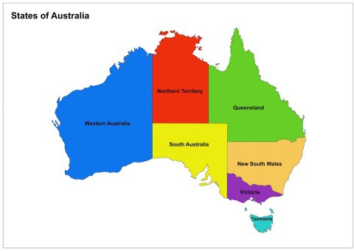
Background
Presentation
Intro | Markets | Sales | Per Capita Sales | Recommendation
A retail chain that operates in clothing retailing is currently looking to expand its operations.
Currently it operates in New South Wales in Australia
Three areas of expansion within Australia are: Queensland, Victoria, and Western Australia.

Slide 2










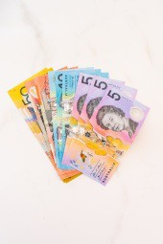




Presentation
Intro | Markets | Sales | Per Capita Sales | Recommendation
Net Proﬁt Margin Distribution
State
Looking at the competition
13%
12%
11%
10%
Victoria has the highest median net proﬁt margin, and has a smaller variance.
9%
The current market, New South Wales, and Western Australia is more dispersed so there is more uncertainty.
Net Proﬁt Margin
8%
7%
Queensland also has a smaller dispersion, however its median net proﬁt margin is lower than Victoria.
6%
5%
4%
3%
2%
1%
0%
NSW
QLD
VIC
WA

Slide 3
Presentation
Intro | Markets | Sales | Per Capita Sales | Recommendation
Industry Analysis
Industry
State
Turnover $M
600
New South Wales
400
200
0
300
Turnover $M
200
Queensland
100
0
There seems to be a upward trend in all markets.
Turnover $M
400
Victoria
200
However, there are diﬀerent population sizes in each market.
0
150
Turnover $M
100
Western
Australia
50
0
2010
2011
2012
2013
2014
2015
Month of Date

Slide 4

Presentation
Intro | Markets | Sales | Per Capita Sales | Recommendation
Sales Per Capita
Industry: Per Capita Sales
State
100
Sales per Capita $
New South Wales
50
0
Victoria looks like the most positively trending choice.
Sales per Capita $
100
Queensland
50
The current market also has a good outlook.
0
Queensland and Western Australia have negative trends.
Sales per Capita $
100
Victoria
50
However the R-square for them are very low with p > 0.05.
0
100
Sales per Capita $
Western Australia
50
0
2010
2011
2012
2013
2014
2015
Month of Date

Slide 5
Presentation
Intro | Markets | Sales | Per Capita Sales | Recommendation
Recommendation
With the results in the boxplots and per capita sales, Victoria seems to be the best market to expand.
With seasonality included, the forecast for that region will help the clothing retail company grow.
Sales Per Capita
State
100
Sales per Capita $
Victoria
50
0
2010
2011
2012
2013
2014
2015
2016
2017
2018
Month of Date

